Slide 1
Introduction to SFML
By: Anh Pham

Slide 2
Topics:
SFML
Simple Game format
How to read documentation of SFML
Sprite
Interaction with sprite

Slide 3
SFML
What is SFML?
What OS does it run on?
What language can use SFML?

Slide 4
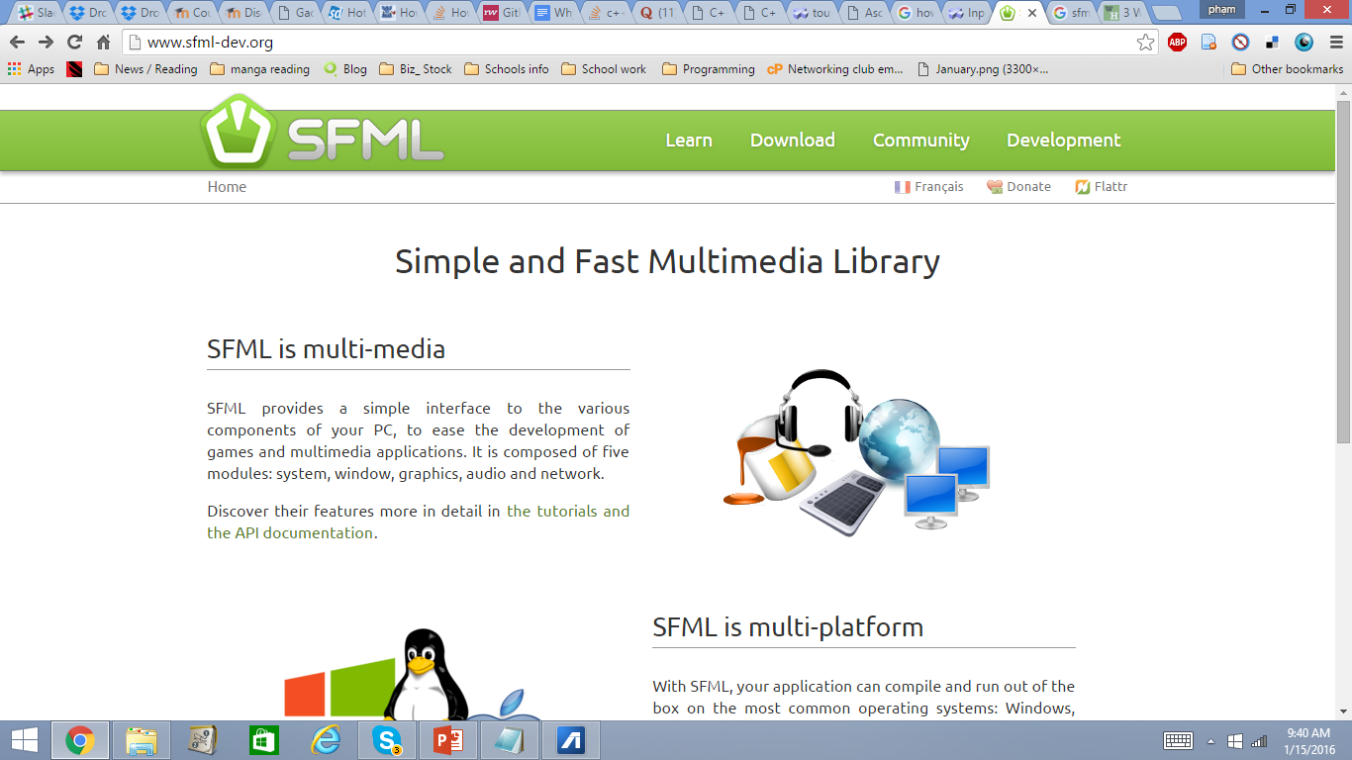

Slide 5
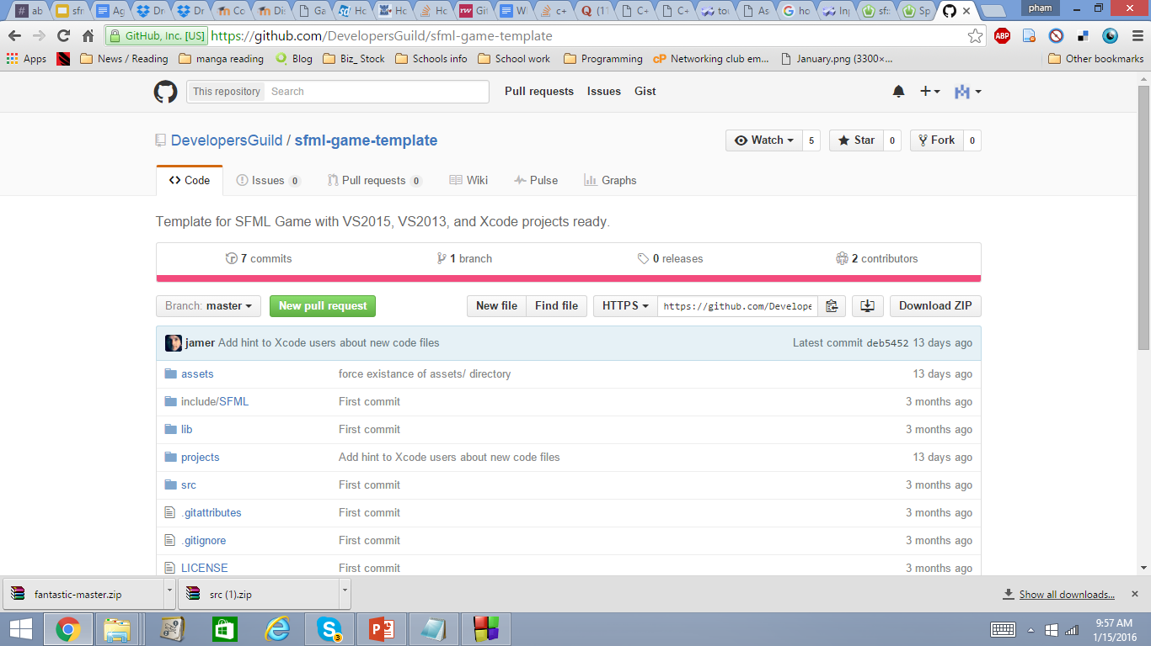
SPRITE

Slide 6
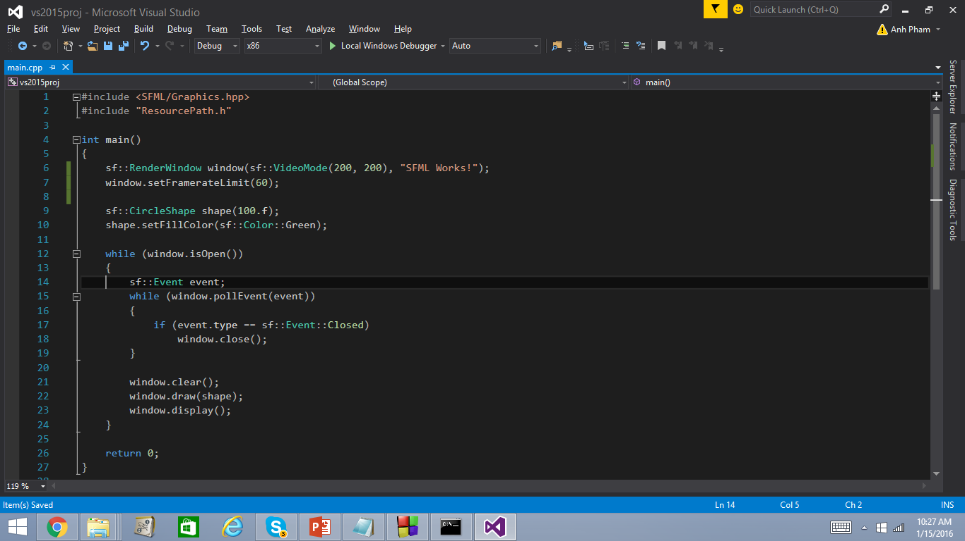

Slide 7
SFML SHAPE
Shape: SFML classes that represent shape entities.
xy co-ordinates
Read: Introduction, common shape properties, Circle, regular Polygons, Customized shape

Slide 8
Transforming Shape Entities
Read with “Jumping Ant” and practice:
position, rotation, scale, origin
Read : bounding boxes

Slide 9
And … Action!!!

Slide 10
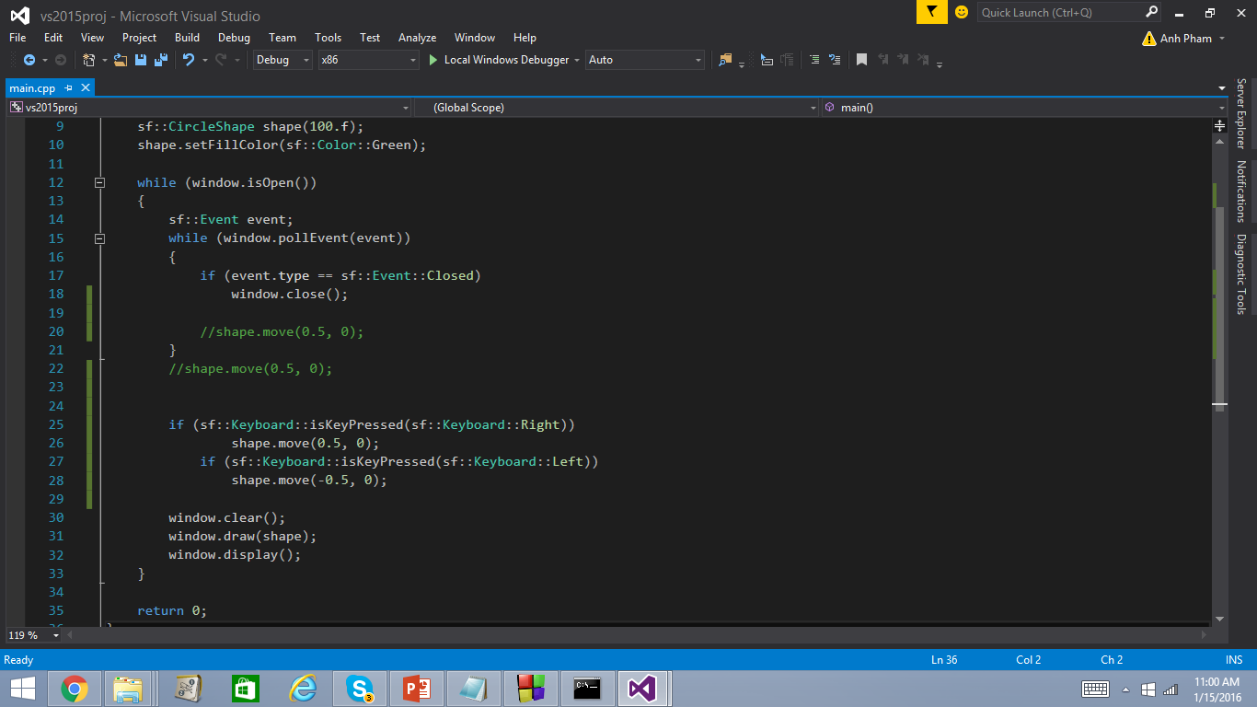

Slide 11
Sprite && Texture
Texture - An image
Sprite - Texture + rectangular entity
Download texture to src folder

Slide 12
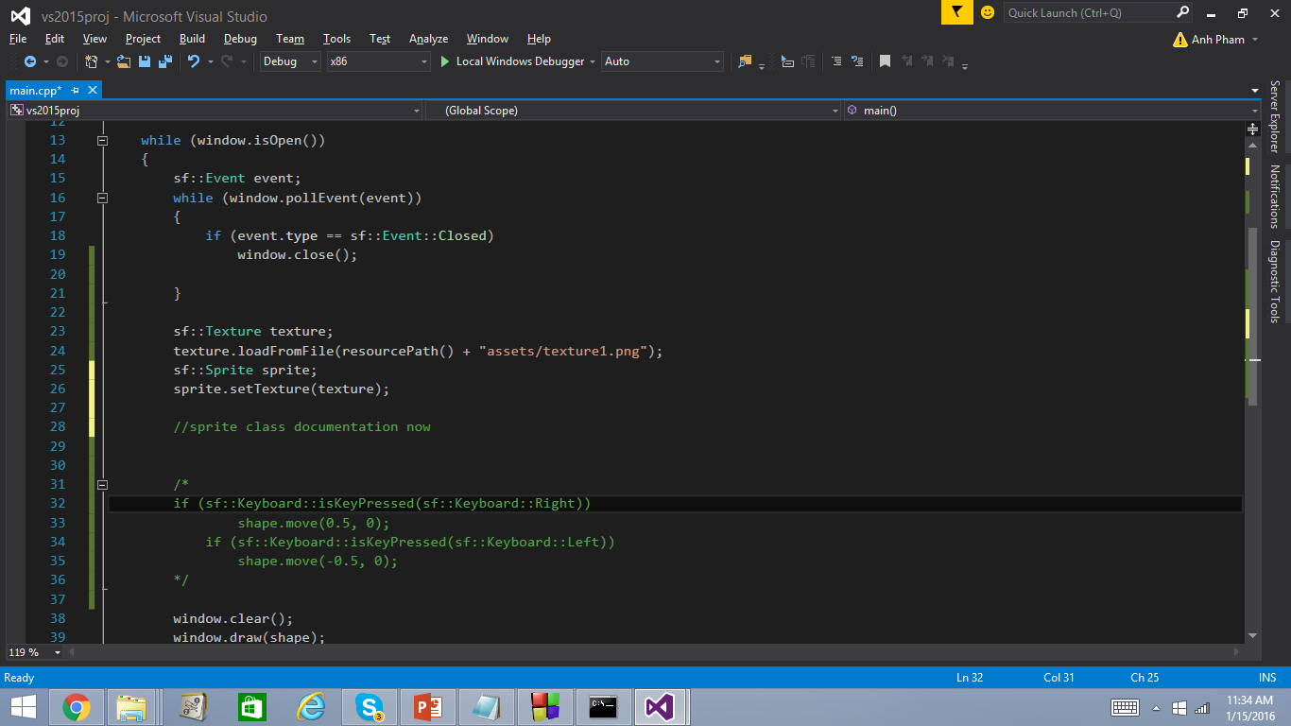

Slide 13
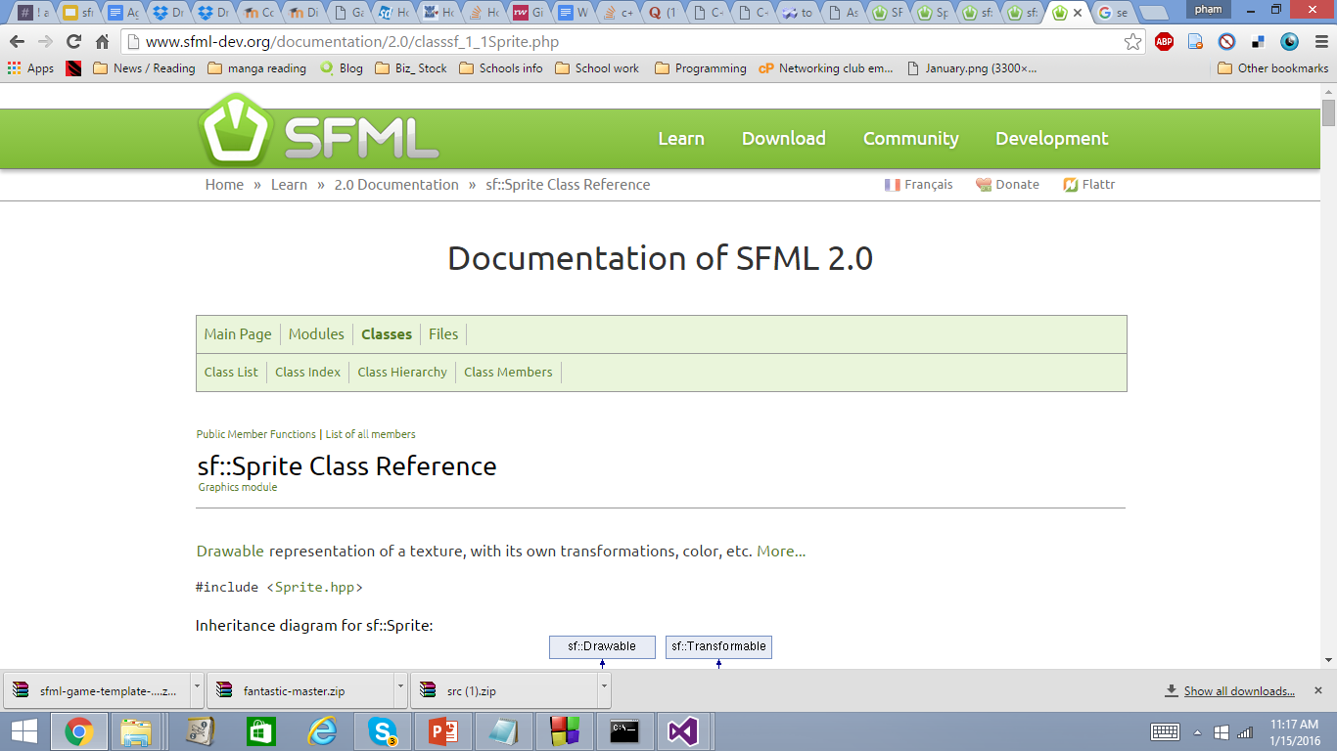

Slide 14
Basic debugging
Don’t delete your code, comment it out
system(“pause”)
Cout “everything”
What’s your experience with debugging?

Slide 15
PROJECT
Team decide your main character appearance
Create sprite
Makes it move by keyboard
Makes it move by mouse click

